Slide 1

DSLab 2020
The Data Science Lab
Data Science Lab – Spring 2020

Slide 2
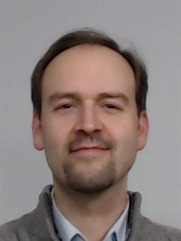





Introducing the team
Eric Bouillet
Most modules
Guillaume Obozinski
Modules 1 & 5
Weeks 4, 12-13
Tao Sun
Assistant
Christine Choirat
Module 1
Weeks 2-3
Sofiane Sarni
Module 4
Week 10
Olivier Verscheure
Most modules
Pamela Delgado
Module 3
Weeks 1, 7, 8 & 9
John Stephan
Teaching Assistant
EDOC-IC
Haoqian Zhang
Teaching Assistant
EDOC-IC
Kayaalp Mert
Teaching Assistant
EDOC-IC

Slide 3
Outline
General introduction
An overview of our DSLab
This week’s lab
Crash course of Python 3.x in Jupyter Notebook

Slide 4
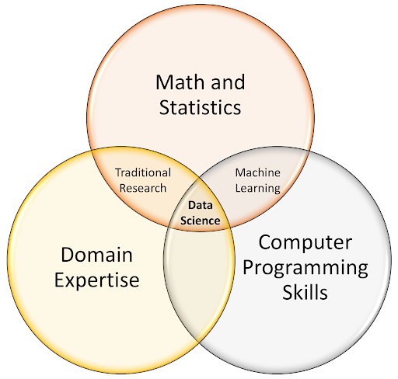
Conway’s Data Science Venn diagram

Slide 5
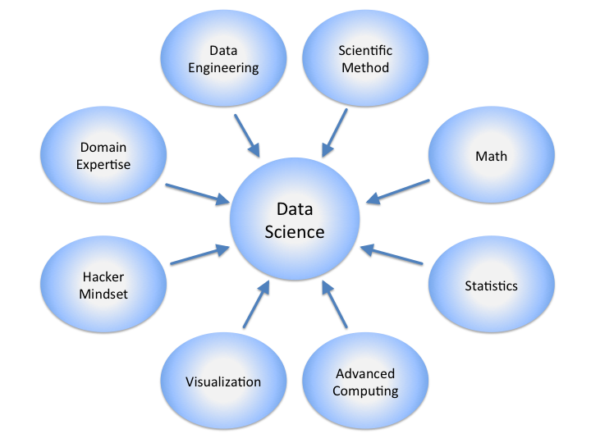
What is Data Science?

Slide 6
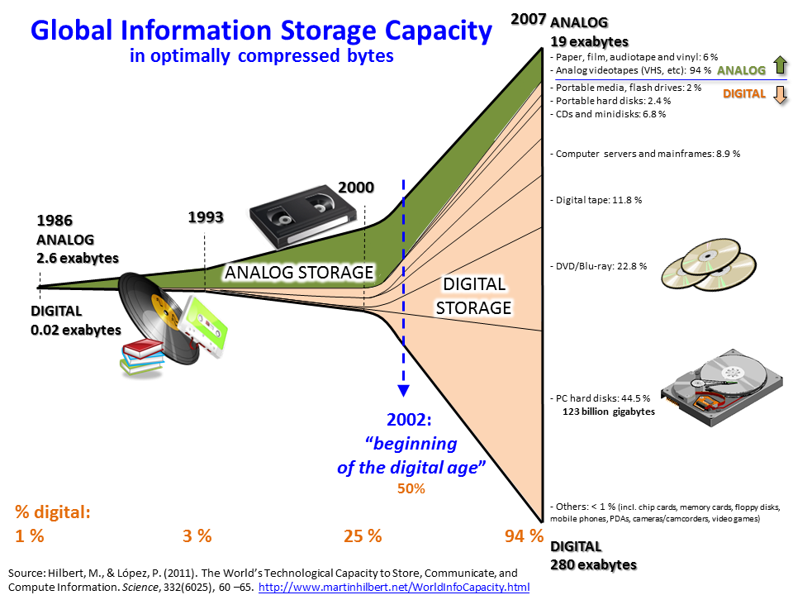
Digital
age

Slide 7

Big Data
In 2013
Twitter 7 To/day
Facebook 10To/day
In 2015, Every 60 seconds on Facebook
510 comments are posted,
293,000 statuses are updated,
136,000 photos are uploaded…
Many banks, large stores, companies working in logistics, with sensors, with IoT, webmarketing companies, web platforms, digital factories are generating large amounts of data that are difficult to structure, model and analyze.
Bibliothèque Nationale de France : 14 To

Slide 8

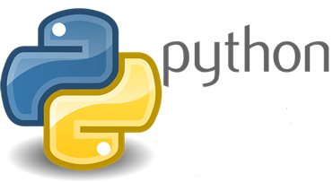


Instant quiz
Python & Anaconda
Jupyter Notebooks
Git(Lab/Hub)
Docker containers
Kaggle

Slide 9
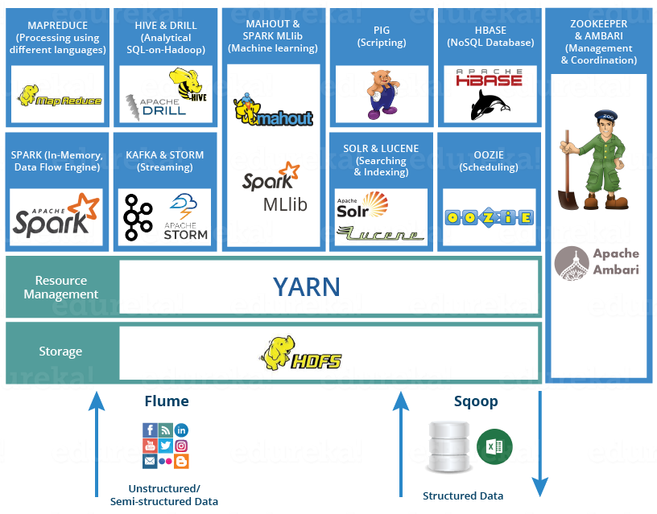
Instant quiz
Python & Anaconda
Jupyter Notebooks
Git(Lab/Hub)
Docker containers
Kaggle
HDFS, YARN, Hive, HBase
Spark (Streaming)

Slide 10
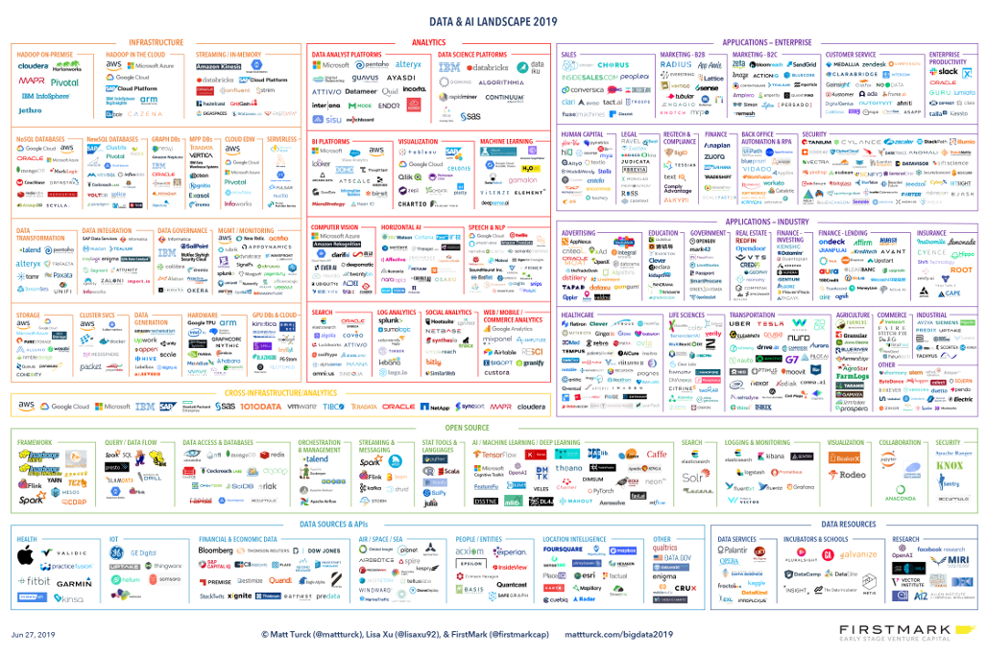
Data Science tools landscape 2019

Slide 11
The problem and the data
Which data for which problem formulation?
Understanding where the data is…
Collecting the data
Determining the data structure (datalake, structured database)
Finding the meta-data describing the encoding of the data
Putting in place labelling schemes / fix existing labelling scheme

Slide 12
Big data and data wrangling
GFS : Google file system
HDFS: Hadoop Distributed File System
MapReduce: scheme to process distributed data
YARN: Resource manager for HDFS
Spark: distributed cluster-computing framework
Kafka: work with streaming data (with Spark)

Slide 13
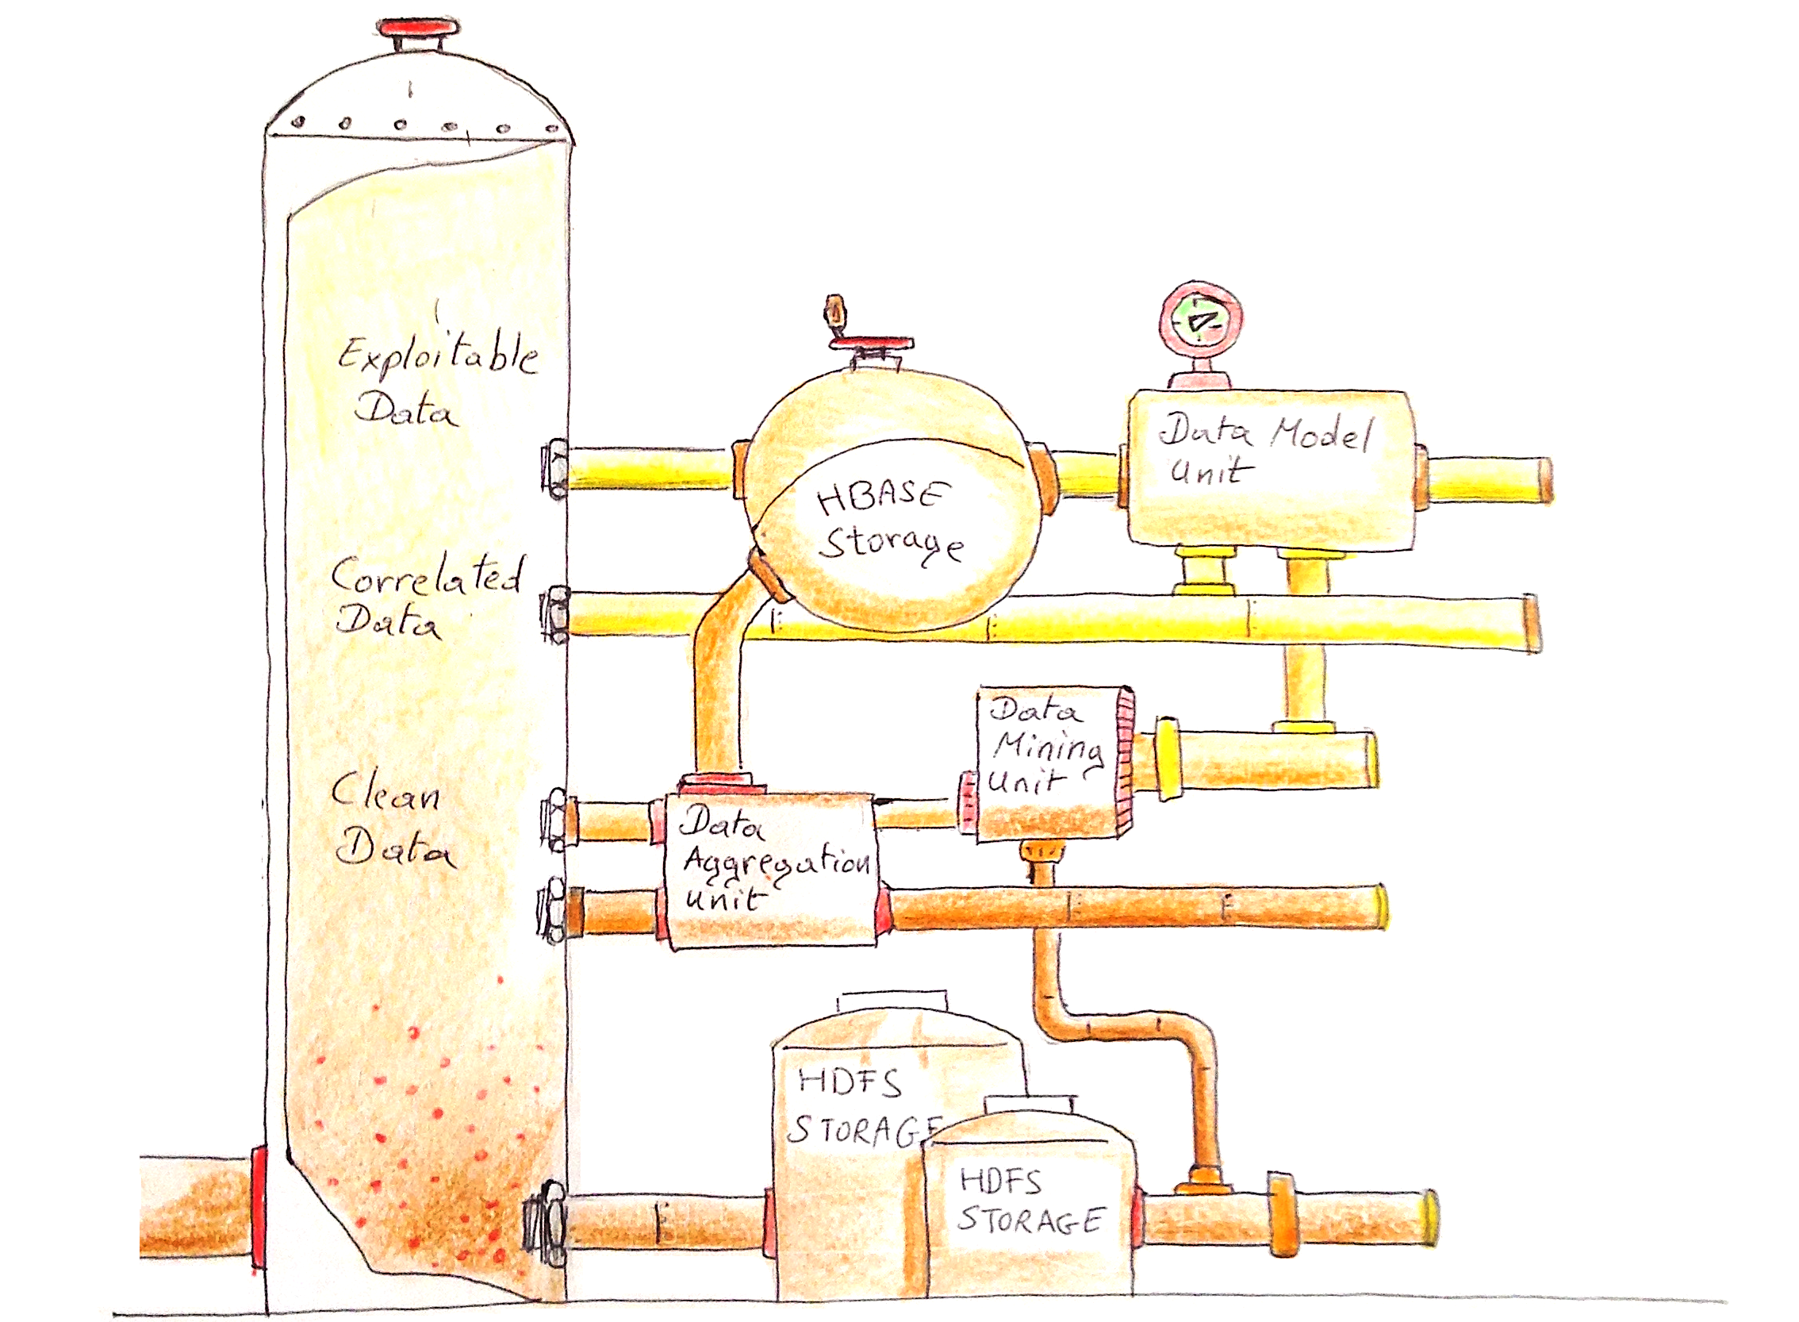
Like oil, data must be refined

Slide 14
Preparing the data
🛢🛢 Merge databases
🧰 Record linkage
👾 Errors
Inconsistencies
🧰 Detect / fix / remove
Duplicate entries
🧰 Deduplication
👾 Outliers
🧰 Anomaly Detection
🧰 Robust Machine Learning
👾 Missing data
🧰 Imputation techniques
👾 Non-stationarity
Seasonal effects
Drifts
Set horizon to retrain
Sudden changes:
🧰 Change point detection

Slide 15
What you will learn in this lab
ML/stats for real world data (anomalies, outliers, missing data, etc)
Hear about a number of concrete data science projects on which the Industry Team at SDSC works on with industry partners
Hadoop, Spark, Kafka
Work with large scale data
Batch or streaming data

Slide 16

Mission of the Swiss Data Science Center:
Accelerating the adoption of Data Science and Machine Learning techniques within academic disciplines of the ETH Domain, the Swiss academic community at large, and the industrial sector in Switzerland.
Academic team: 16, Industry team: 12, Renku/engineering team: 15
SDSC website: https://datascience.ch
Master Students projects: https://www.epfl.ch/research/domains/sdsc/

Slide 17


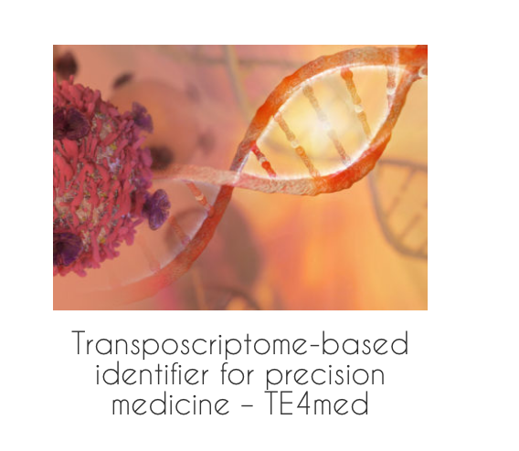

A few of our academic projects

Slide 18
Introducing the lecturing team
Eric Bouillet
Most modules
Guillaume Obozinski
Modules 1 & 5
Weeks 4, 12-13
Tao Sun
Assistant
Christine Choirat
Module 1
Weeks 2-3
Sofiane Sarni
Module 4
Week 10
Olivier Verscheure
Most modules
Pamela Delgado
Module 3
Weeks 1, 7, 8 & 9
John Stephan
Teaching Assistant
EDOC-IC
Haoqian Zhang
Teaching Assistant
EDOC-IC
Kayaalp Mert
Teaching Assistant
EDOC-IC

Slide 19
An overview of our lab
Spring 2020 - week #1

Slide 20
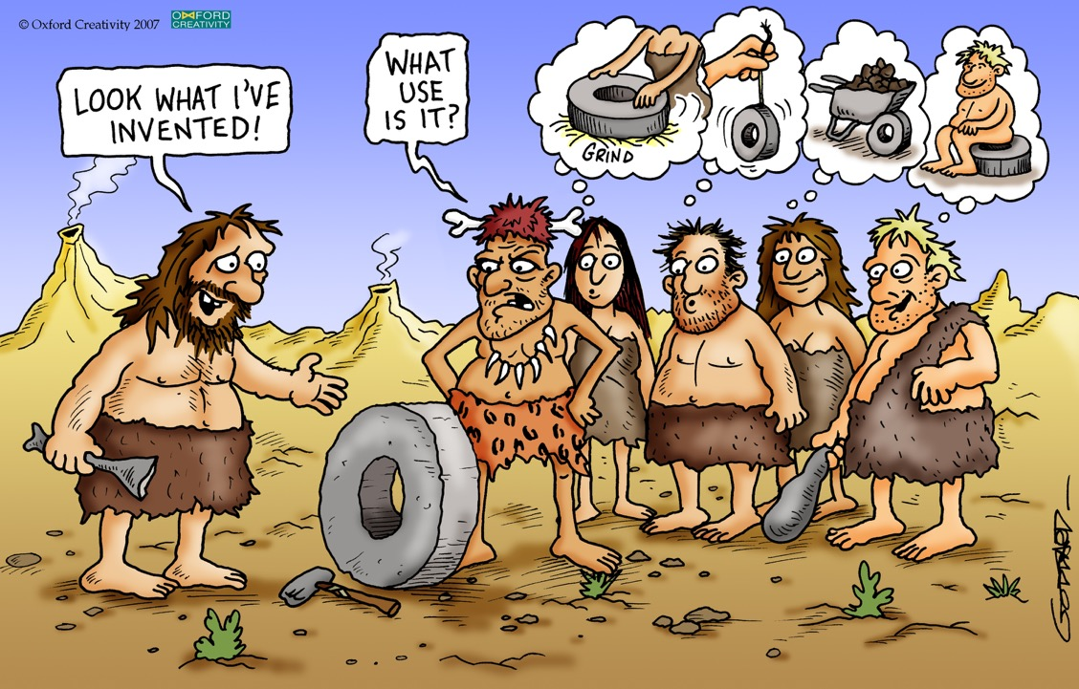
4+1 Modules in 14 weeks
Crash-course in Python for data scientists (2 weeks)
Distributed computing with a Hadoop Distribution (3 weeks)
Distributed machine learning with Apache Spark (3 weeks)
Real-time data acquisition and processing (2 weeks)
Data science as a journey!
Very hands-on and practical
3+ instructors for every lab
Final project (3 weeks)
Course webpage: http://epfl-dsplab2020.github.io
credit: oxford creativity, https://www.triz.co.uk/

Slide 21
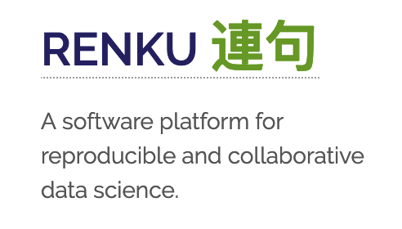

The labs using Renku
Renku is a form of Japanese collective poetry
Renku= a platform entirely developed at SDSC (12 senior software and systems engineers)
Goal: reproducible collaborative research in data science
It is version-control solution for your whole data science environment (code, data, execution pipeline)
Environment independent thanks to Dockers
Useful to teach in hands on computer science
It supports open science, traceability and reproducibility of science
https://datascience.ch/renku/
Eric Bouillet
Rok Roskar
Olivier
Verscheure
Christine
Choirat

Slide 22
Assessment
60% continuous assessment during the semester
One project per module
Groups of 4 students
Projects graded within 2 weeks
40% final project
Final project in the classroom
Groups of 4 students
credit: oxford creativity, https://www.triz.co.uk/

Slide 23
Hardware / Software Resources
Please bring your own laptop!
Renku platform
IC Cluster of 4 servers
Hadoop Cluster
Hortonworks Data Platform
IC Cluster of 12 servers
Notes:
HDP: HortonWorks Data Platform

Slide 24
Logistics
Lab on Wednesday’s 13:00 – 16:00 in INF 01
Lab’s github: https://epfl-dslab2020.github.io/
Slack epfl-dslab2020.slack.com
Office hours will be announced during homeworks

Slide 25
Module 1: Crash-course in Python for data scientists
Week #1
Jupyter Notebooks
Python 3.x
NumPy, Pandas, Matplotlib, Scikit-Learn
Week #2
Reproducible data science
Git, Docker, Renku
credit: oxford creativity, https://www.triz.co.uk/
Notes:
HDP: HortonWorks Data Platform

Slide 26
Module 2: Distributed computing with Hadoop
Week #3
Introduction to big data, best practices and guidelines
Loading & querying data with Hadoop
HDFS, Hive
Week #4
Data wrangling with Hadoop
Assessed project 1
Week #5
Introduction to distributed computing and the Spark runtime architecture
Python on Spark
Use basic RDD manipulations
credit: oxford creativity, https://www.triz.co.uk/

Slide 27
Module 3: Distributed processing with Apache Spark
Week #6
Spark data frames
Assessed project 2
Scaling up to Hadoop cluster with Hive and Spark
Weeks #7
Advanced python for Spark, Spark optimization
Spark pipelines, Spark MLlib, classifiers
Week #8
Assessed project 3
Machine mining with Spark
credit: oxford creativity, https://www.triz.co.uk/
Notes:
Resilient Distributed Datasets (RDD) is a fundamental data structure of Spark.

Slide 28
Module 4: Real-time data acquisition and processing
Week #9
Introduction to data stream processing
Overview of MQTT as sensor protocol for IoT
Apache Kafka for stream processing
Week #10
Advanced data stream processing concepts on Spark with Kafka
Assessed project
Process streaming data from real-time train geolocation data
credit: oxford creativity, https://www.triz.co.uk/
Notes:
s

Slide 29

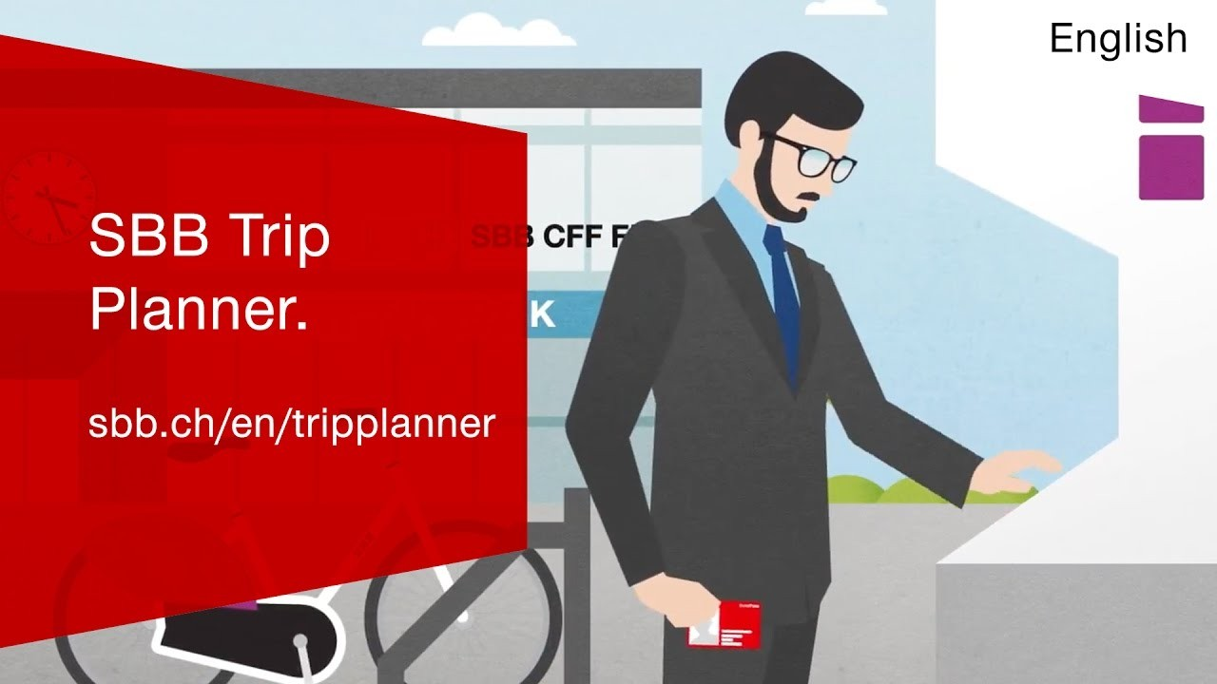
Module 5: Final assignment
Robust Journey Planning
credit: oxford creativity, https://www.triz.co.uk/
Notes:
s

Slide 30
Module 5: Final assignment
Week #11 - #17
Teams of 4
6min video presentation + 10 mins Q&A
credit: oxford creativity, https://www.triz.co.uk/
Notes:
s

Slide 31
Today’s assumption of a deterministic world
Meeting Zurich HB @ 10:30… from St-Sulpice
6 minutes to catch train in Morges
16 minutes to catch train in Morges

Slide 32
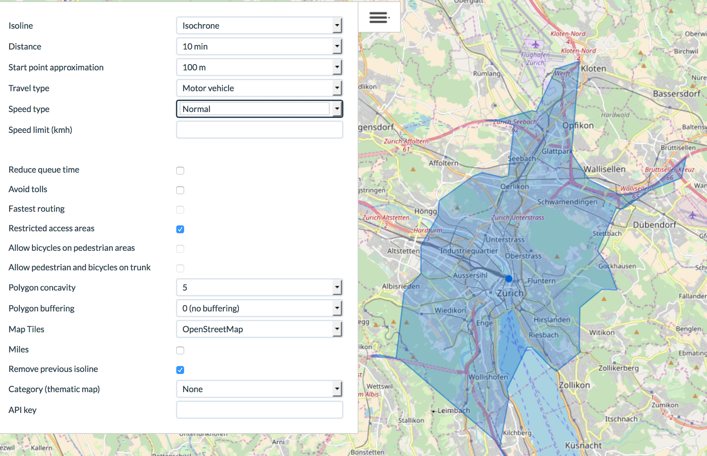
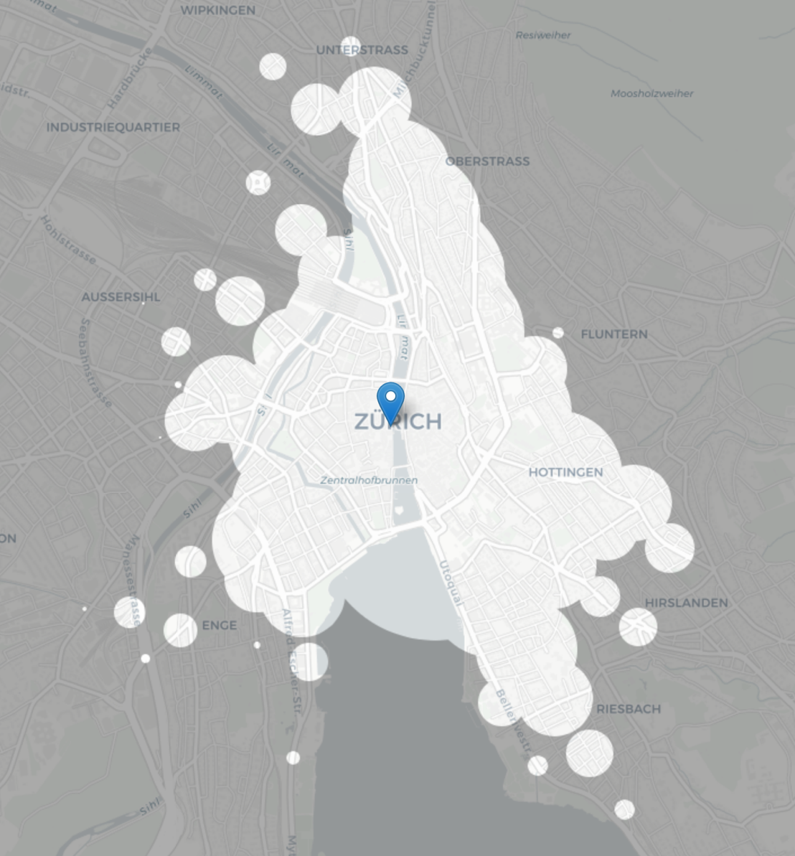
Overall objective
Display isochronous map
Start your journey e.g. at Zurich HB
How far can you go within M minutes Q% of the time?

Slide 33

Rest of today’s module
Sylvia Quarteroni
Presentation of the
Industry team
Pamela Delgado
Jupyter notebooks with Renku
Python starter and scientific toolkits

